Slide 1

Decentralised Voting System App
Hideg Paul & Guia Alex - 933

Slide 2
Decentralized App
01
WHAT ?
02
WHY ?
Is a type of application that runs on a decentralized network of computers rather than a single, centralized server. In a traditional centralized application, all data and logic are stored and processed on a central server controlled by a single entity.
there is no single point of control or failure.
are often designed to be censorship-resistant,/
cannot be easily shut down or controlled by any single entity
can give users greater control over their own data

Slide 3
What is Decentralized Voting?
It refers to a voting system where the process of casting and tallying votes is distributed across a network of computers, rather than being controlled by a single centralized authority.

Slide 4
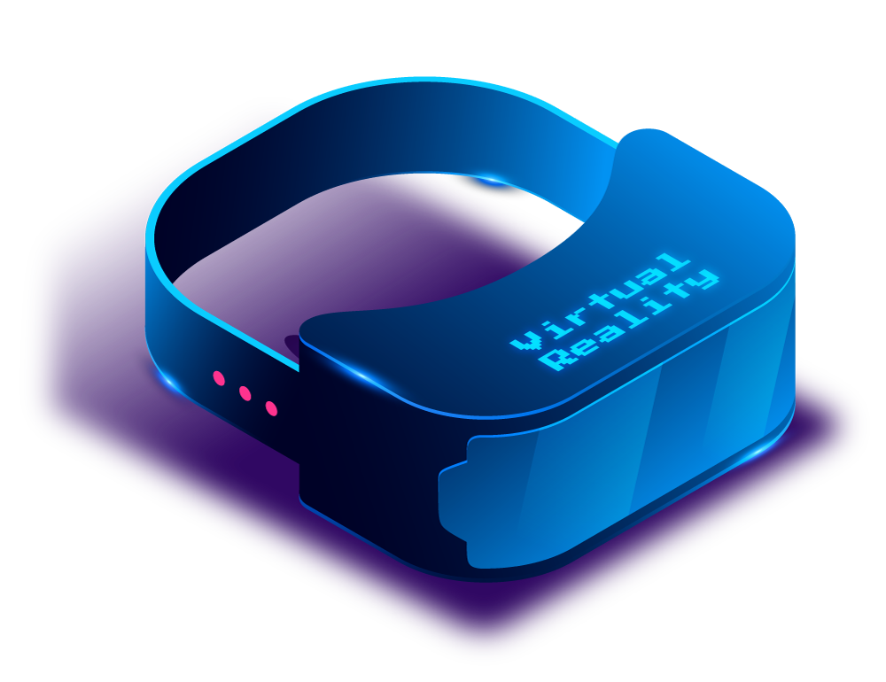
MAIN PURPOSE
The decentralized voting system app aims to revolutionize democratic processes by providing a secure, transparent, and accessible platform for conducting elections and decision-making
No central authority: There is no single entity controlling the voting process.
Transparency: All voting activities are transparent and visible to all participants.
Security: Enhanced security measures, such as cryptography, ensure the integrity of the voting process.

Slide 5
How It Works
1. Initialization
The app is initialized by deploying the smart contract Ballot.
The chairman is automatically granted the right to vote and is assigned a weight of 1.
The constructor function takes an array of proposal names as input, creating a list of proposals with their initial vote counts set to zero.

Slide 6
How It Works
2. Voting Process
Each eligible voter (address) is registered in the voters mapping, which stores their voting information
The chairman has the authority to register voters and assign voting weights if necessary.
Voters cast their votes by calling the vote function, providing the index of their preferred proposal.
Upon receiving a vote, the smart contract updates the vote count for the corresponding proposal and marks the voter as having voted.
Once a voter has cast their vote, they cannot vote again.

Slide 7
How It Works
3. Tallying Votes
As votes are cast, the smart contract accumulates the vote counts for each proposal.
The proposals array contains the list of proposals, each with its name and vote count.
At any point, the chairman or any participant can query the contract to retrieve the current vote counts for each proposal.

Slide 8
How It Works
4. Winner Determination
Once the voting period ends, the chairman can call a function to determine the winner based on the proposal with the highest number of votes.
The winner is announced, and the voting process is concluded.

Slide 9
Future Outlook
Potential Impact of Decentralized Voting on Democracy and Governance
Opportunities for Further Research and Development
Enhanced Transparency
Increased Trust and Confidence
Accessibility and Inclusivity
Usability and Accessibility
Social and Ethical Implications
Education and Awareness

Slide 10



Conclusion
Decentralized voting systems have the potential to revolutionize democracy and governance. By leveraging blockchain technology, these systems offer transparency, security, and inclusivity in electoral processes. However, further research and development are needed to address scalability, usability, and security challenges.

Slide 11
Demo Time!

